Slide 1
Introduction
The reduced QR decomposition of an arbitrary m × n matrix, m ≥ n , into a product of an m × n matrix Q with orthonormal columns and an n × n upper triangular matrix R such that A = QR can be done using the Gram-Schmidt classical (CGS) and modified algorithms (MGS). The solution of least-squares problems often uses the QR decomposition, and the decomposition plays a very important role in eigenvalue computation. We must be able compute it accurately, and Gram-Schmidt is not as effective as some other algorithms.

Slide 2
Introduction
When using CGS, the columns of Q tend to lose orthogonality in proportion to κ (A), and MGS can have problems when the matrix A is ill-conditioned.

Slide 3
Example 1
>> H = hilb(5);
>> [Q R] = modqrgrsch(H);
>> norm(eye(5)-Q'*Q
ans = 1.1154e-011
>> [Q R] = clqrgrsch(H);
>> norm(eye(5)-Q'*Q)
ans = 5.7917e-008
>> H = hilb(15);
>> [Q R] = modqrgrsch(H);
>> norm(eye(15)-Q'*Q)
ans = 0.9817 % indicates severe effects from ill-conditioned H
NOTE: cond₂(H) = 2.5699 × 10¹⁷

Slide 4
The Givens QR Decomposition
The LU decomposition is developed by applying a sequence of elementary matrices to the left side of A . In the resulting decomposition LU, L is the product of the elementary matrices and U is an upper triangular matrix.
We can use this same idea for the transformation of A into the product QR by applying on the left a sequence of orthogonal matrices called Givens matrices that transform A into an upper triangular matrix R . Each Givens matrix product zeros-out a matrix element in the creation of R .

Slide 5
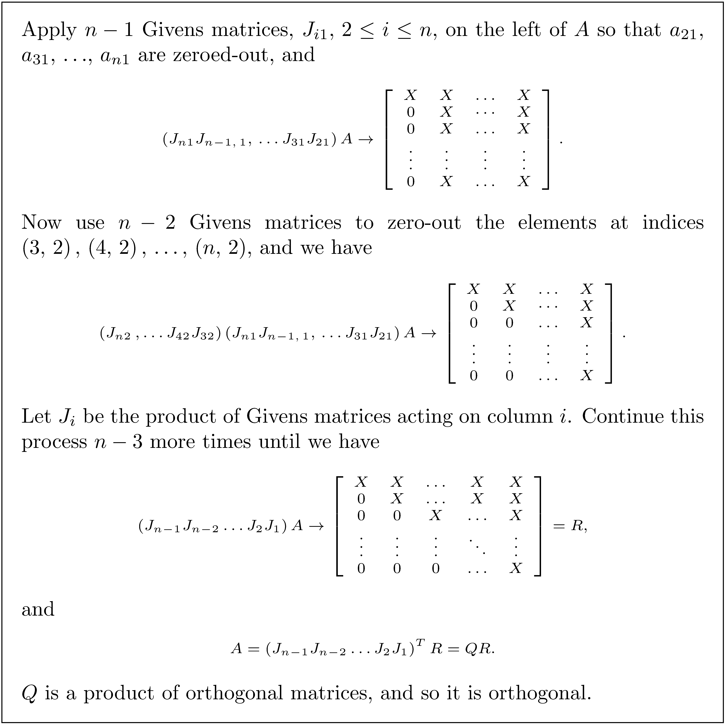
Givens Idea

Slide 6
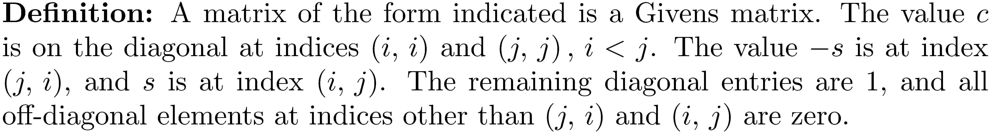
Form of a Givens Matrix
To have orthonormal columns c² + s² = 1.

Slide 7
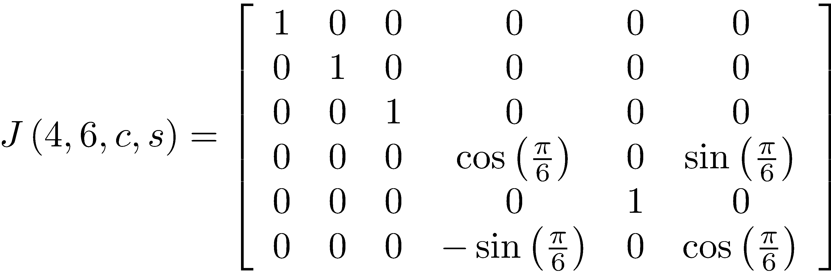
Example of a Givens Matrix
Note that we chose and because In general, we can choose any angle θ and let c = cos(θ), s = sin(θ) and always obtain a Givens matrix.

Slide 8
A Givens Matrix is a Rotation Matrix
is a rotation matrix.
In general, a Givens matrix is a rotation matrix that rotates a pair of coordinate axes through an angle θ in the ( i,j ) plane.

Slide 9
Zeroing a Particular Entry in a Vector using a Givens Rotation
The Givens QR decomposition algorithm relies on being able to place zeros at specified locations in a matrix.
Let and form the product
The product changes only the components i and j of x.

Slide 10
Zeroing a Particular Entry in a Vector using a Givens Rotation
Assume we have a vector x ∈ R^{n} and want to zero-out x_{j} ,j>1 , as illustrated.
Determine the values of i, j, c, and s to use, and then form the Givens matrix by inserting c in locations (i,i) and (j,j), -s into location (j,i) and s into position (i,j) of the identity matrix.

Slide 11
Zeroing a Particular Entry in a Vector using a Givens Rotation
The rotation affects only components i and j of x, so finding c and s can be reduced to a two-dimensional problem.
A two-dimensional rotation matrix has the form and rotates with the product

Slide 12
Zeroing a Particular Entry in a Vector using a Givens Rotation
Find θ so that the result of forming is We have so choose

Slide 13
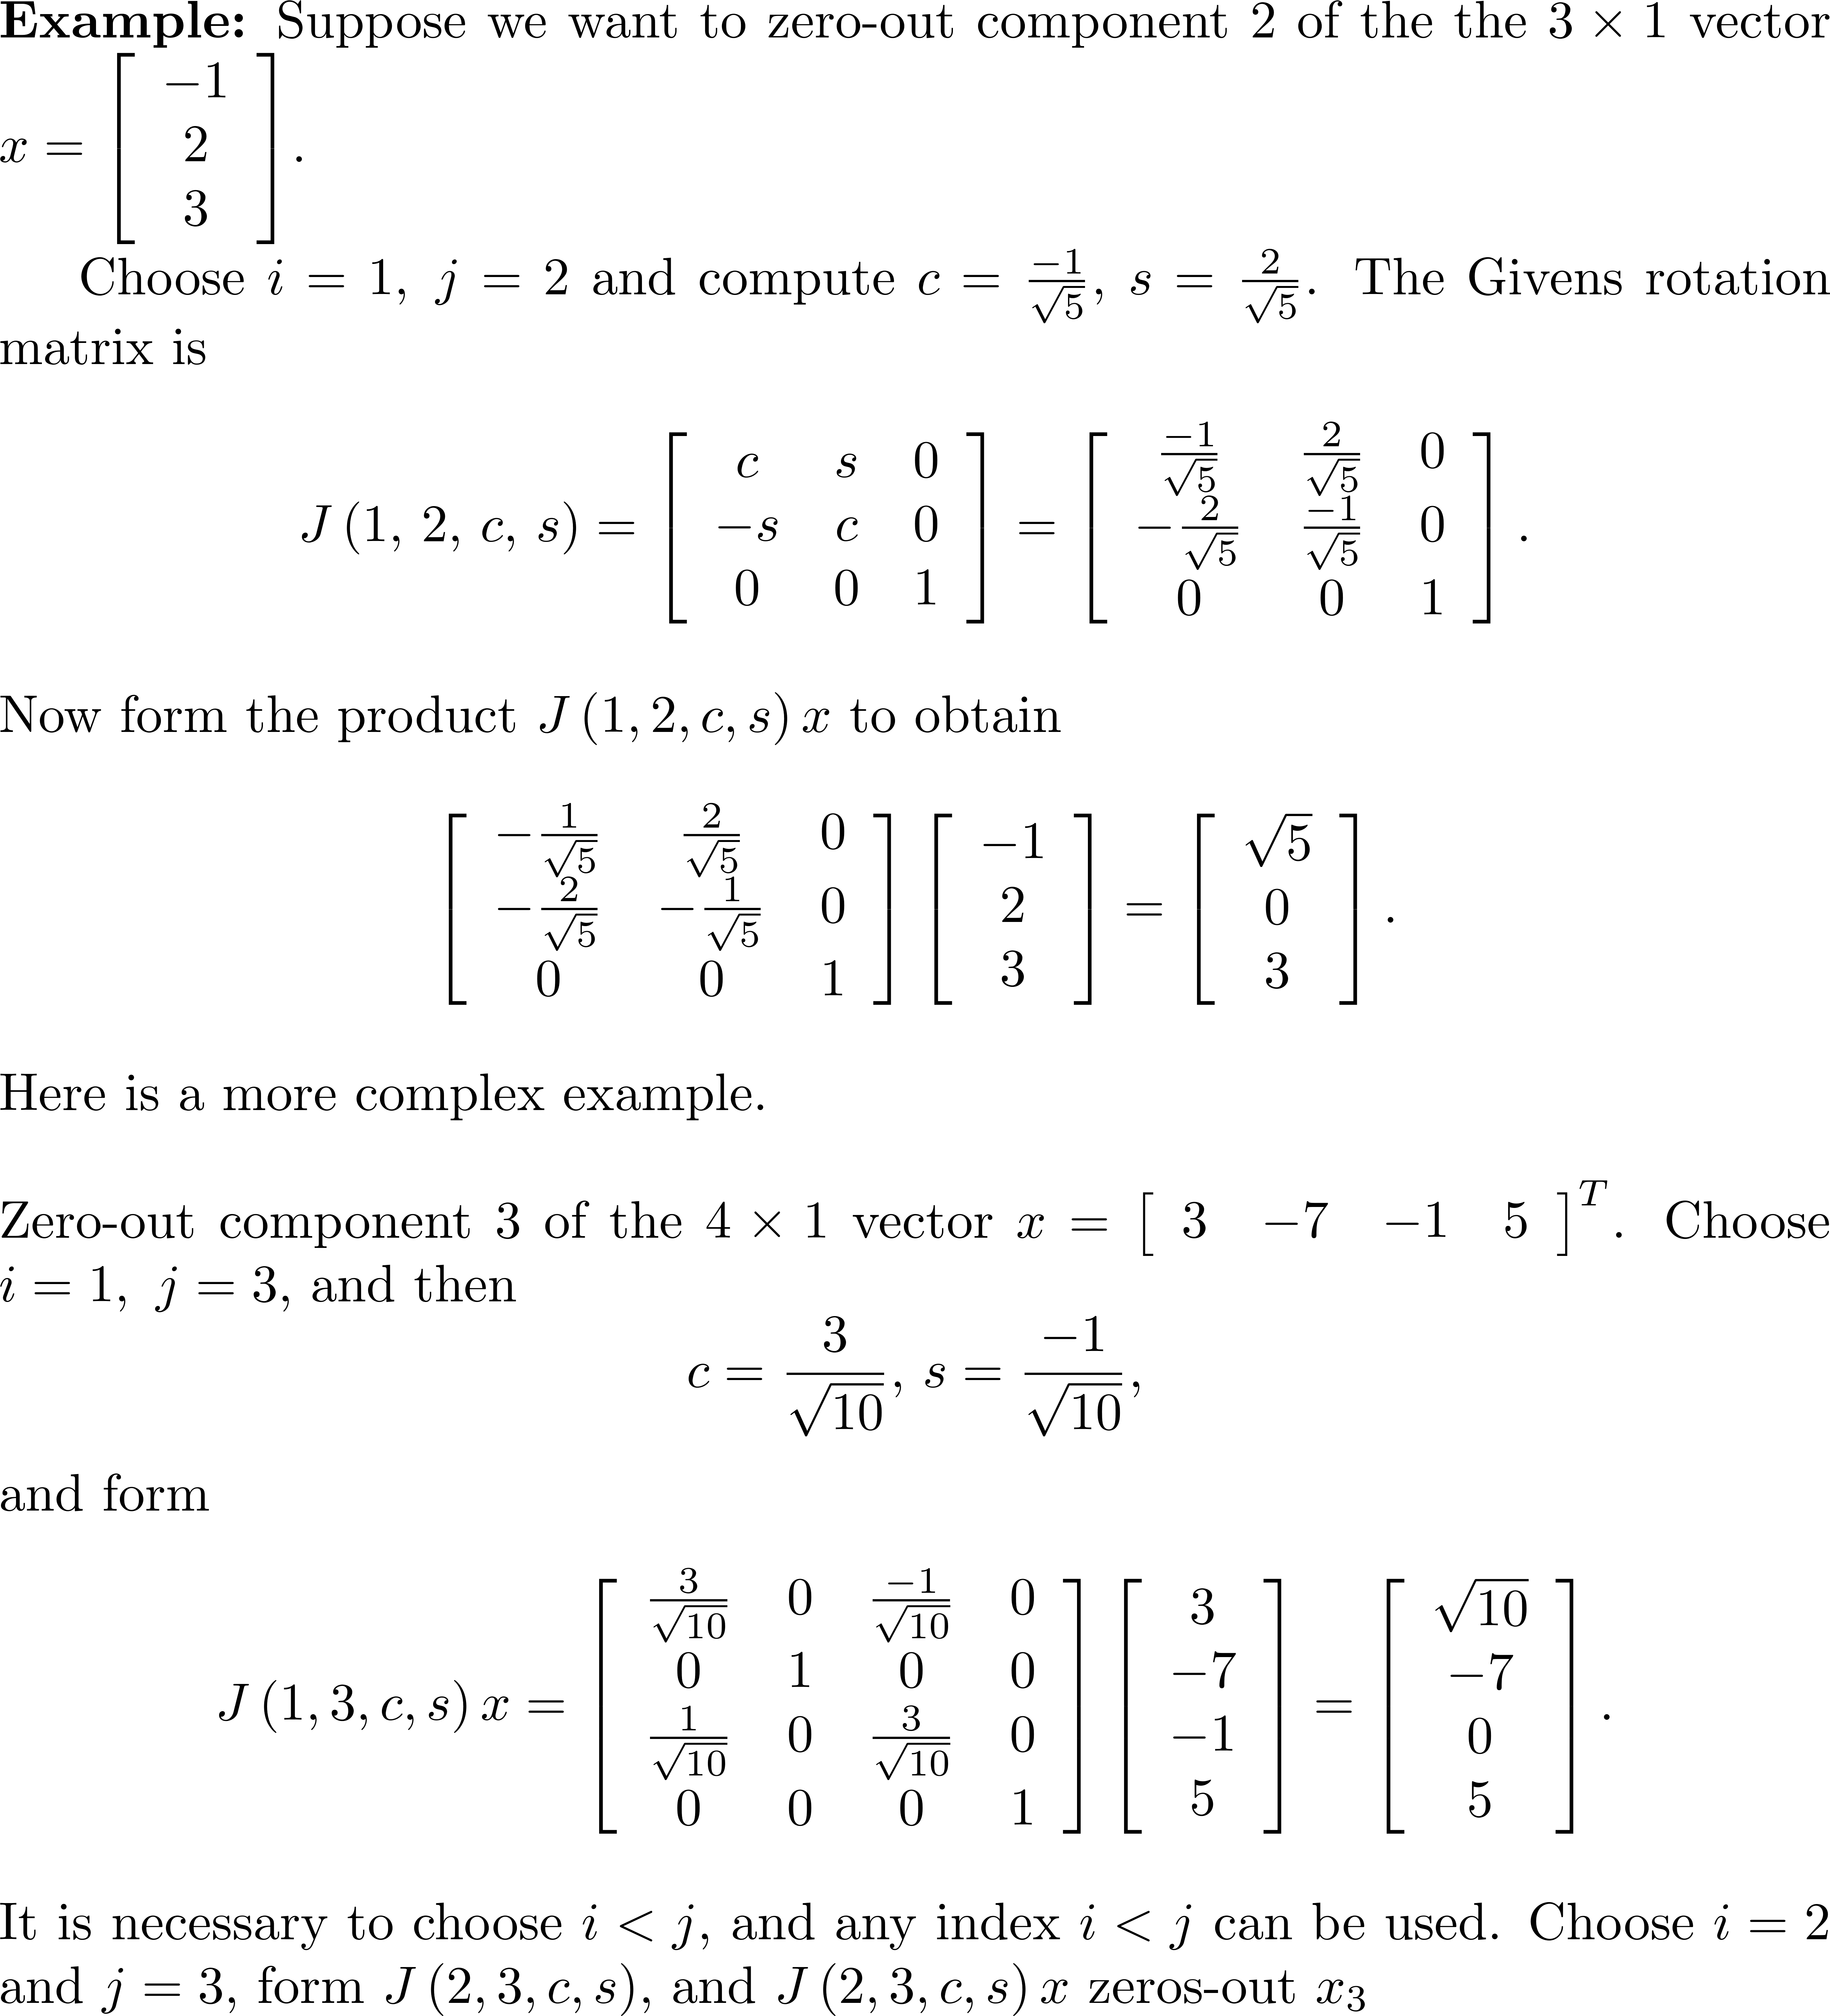
Example 2

Slide 14
Example of a More General Givens Rotation
Let Zero-out x(5) using indices 2 and 5.

Slide 15
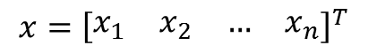
Creating a Sequence of Zeros in a Vector Using Givens Rotations
Given the vector , use a product of Givens matrices to zero-out the n-i elements of x below entry x_{i} .
To zero-out x_{i+1} , compute .
To zero out x_{i+2} , compute .
Continue the process until computing .
$${x=\left[\begin{matrix}x_{1} & x_{2} & … & x_{n}\end{matrix}\right]}^{T}$$
SUMMARY: The product transforms x into a vector of the form .

Slide 16
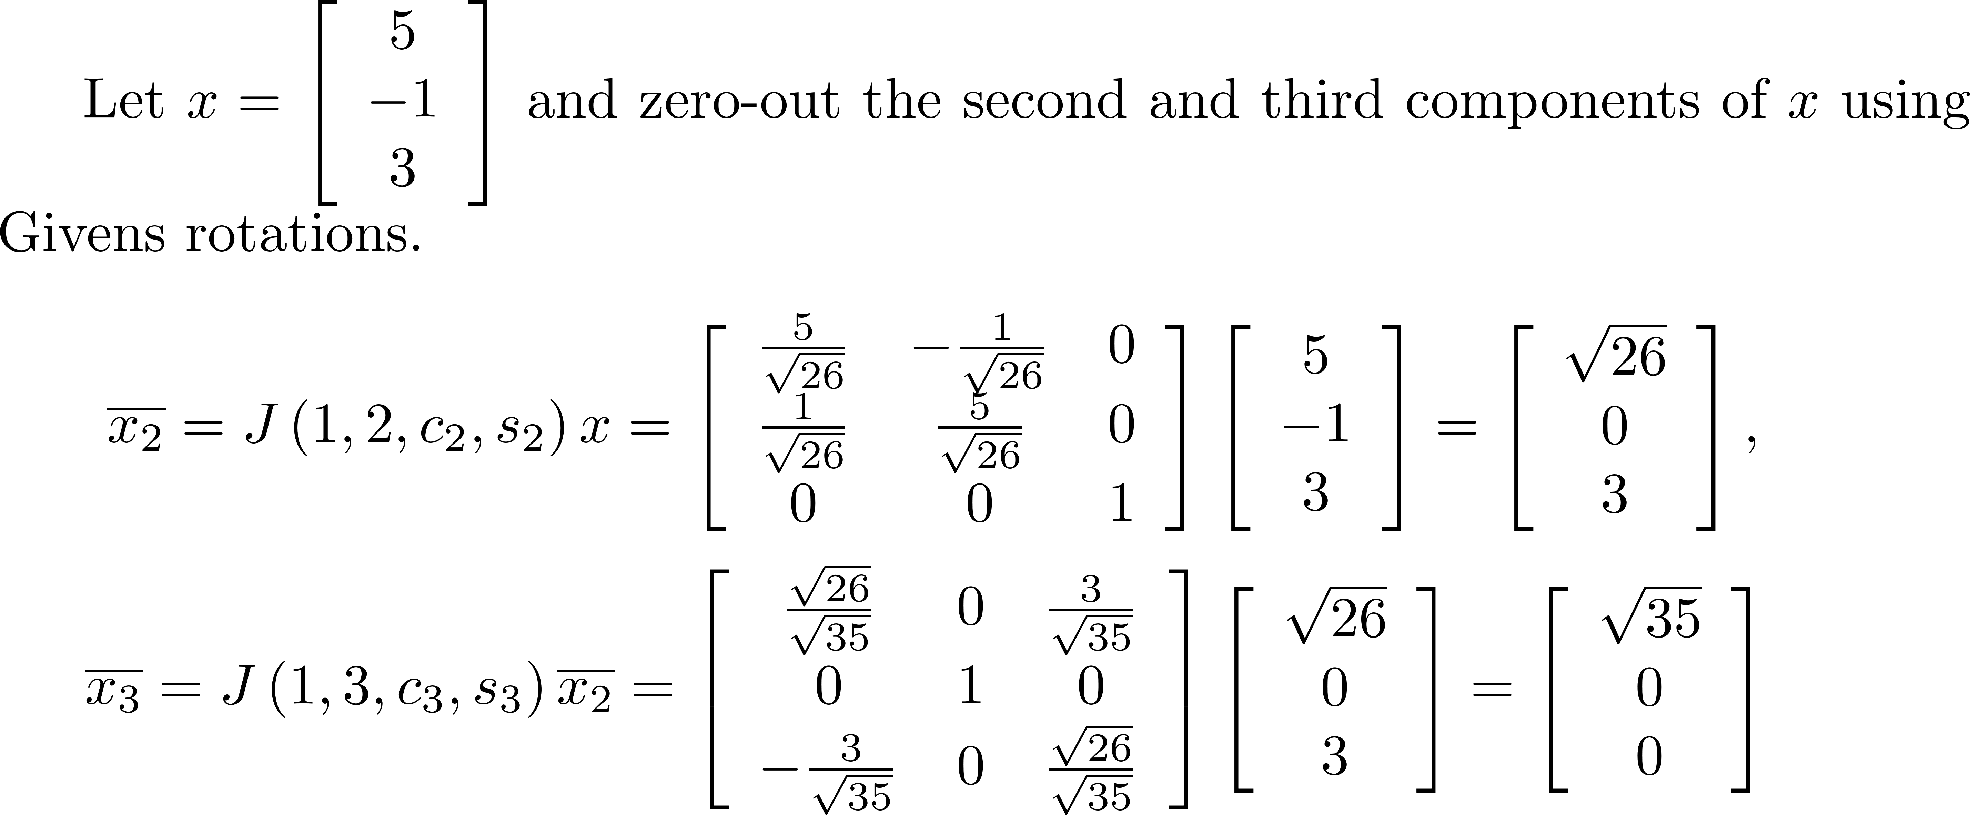
Example 3

Slide 17
Product of a Givens Matrix with a General Matrix
If A is an m × n matrix, a huge advantage when dealing with Givens matrices is the fact that you can compute a product J( i,j,c,s )A without ever constructing J( i,j,c,s ).

Slide 18
Product of a Givens Matrix with a General Matrix
Rows i and j of J( i,j,c,s )A , i<j , have the form: The product J( i,j,c,s )A is very efficient to compute, requiring only 6n flops. Just change rows i and j according to the equations.

Slide 19
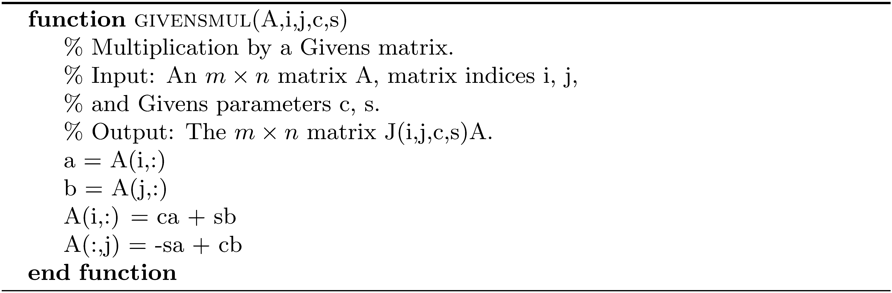
Product of a Givens Matrix with a General Matrix

Slide 20
Zeroing-out Column Entries in a Matrix Using Givens Rotations
Consider the problem of computing the product J( i,j,c,s )A,j>i, so that the result will have a zero at index ( j,i ) and only rows i and j of A will change.
Think of column i as a vector and find c and s using a_{ii} and a_{ji} so the product will zero-out a_{ji} .
Using givensmul, implicitly form a Givens matrix with c at indices ( i,i ) and ( j,j ) , -s at index ( j,i ) and s at index ( i,j ) and compute J( i,j,c,s )A.

Slide 21
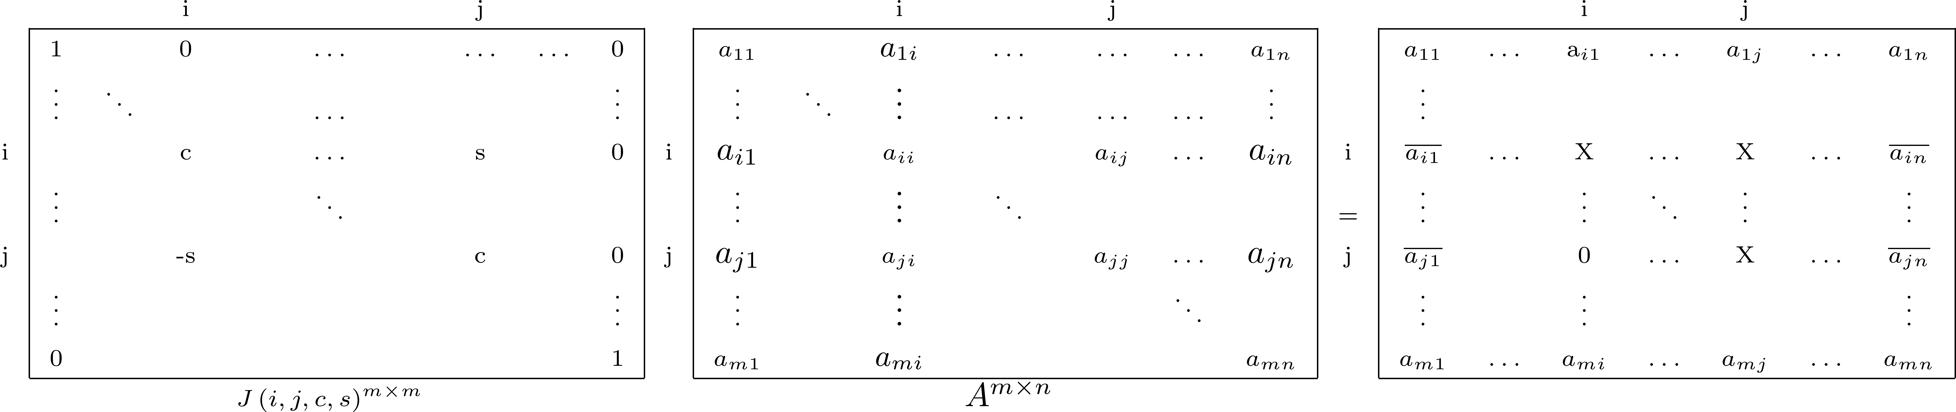
Zeroing-out Column Entries in a Matrix Using Givens Rotations
To zero-out every element in column i below a ii , compute the sequence
$$\overline{A_{i+1}}=J\left(i,i+1,c_{i+1},s_{i+1}\right)A,\overline{A_{i+2}}=J\left(i,i+2,c_{i+2},s_{i+2}\right)\overline{A_{i+1}},…,\overline{A_{m}}=J\left(i,m,c_{m},d_{m}\right)\overline{A_{m−1}}$$

Slide 22
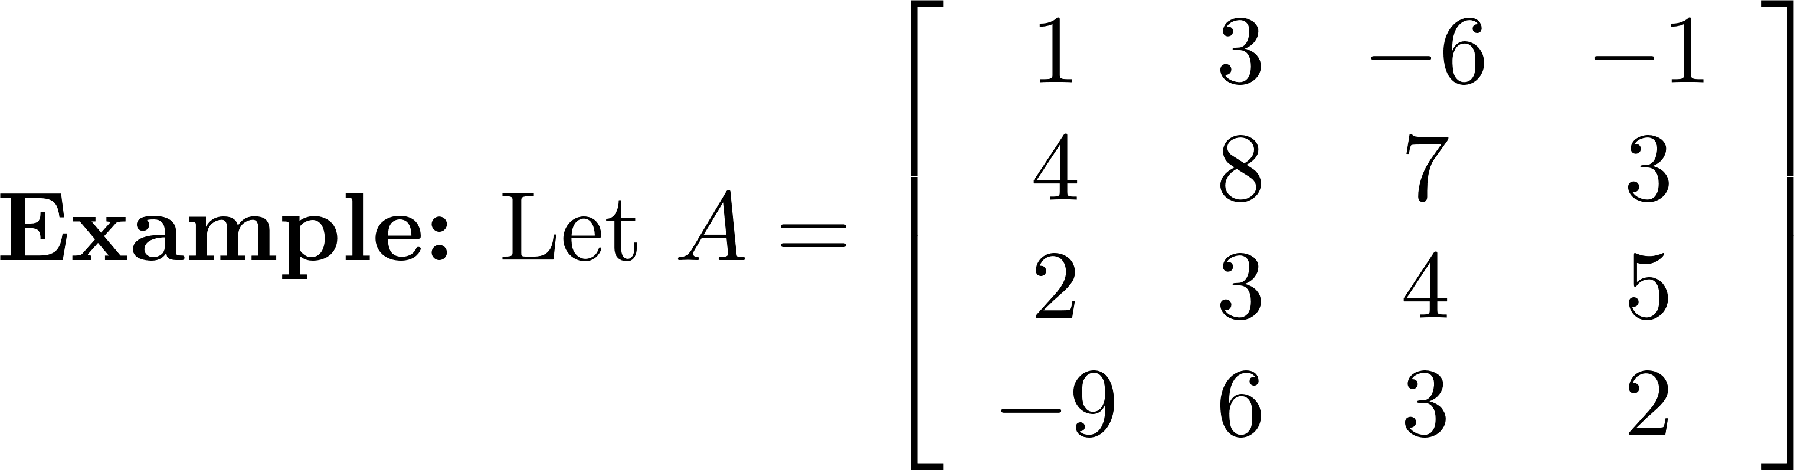
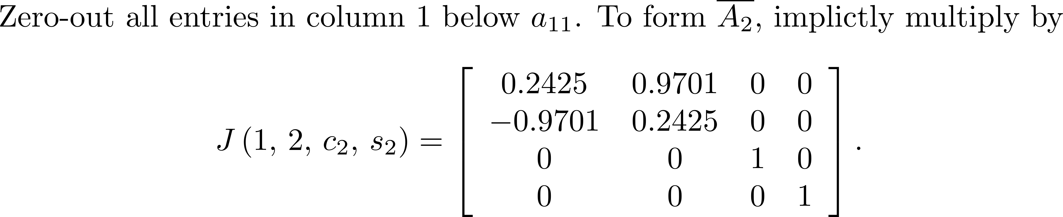
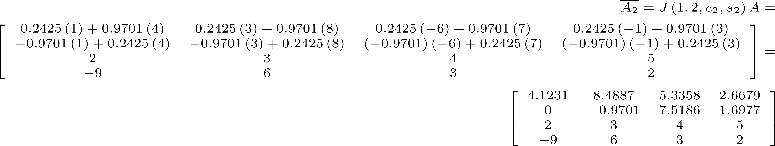
Example 4

Slide 23
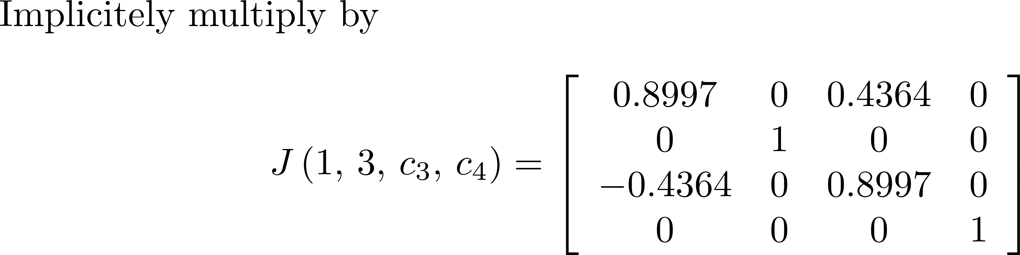
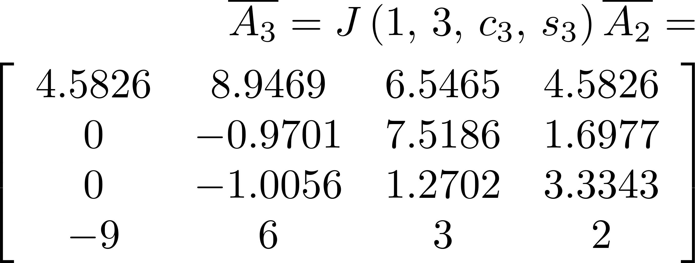
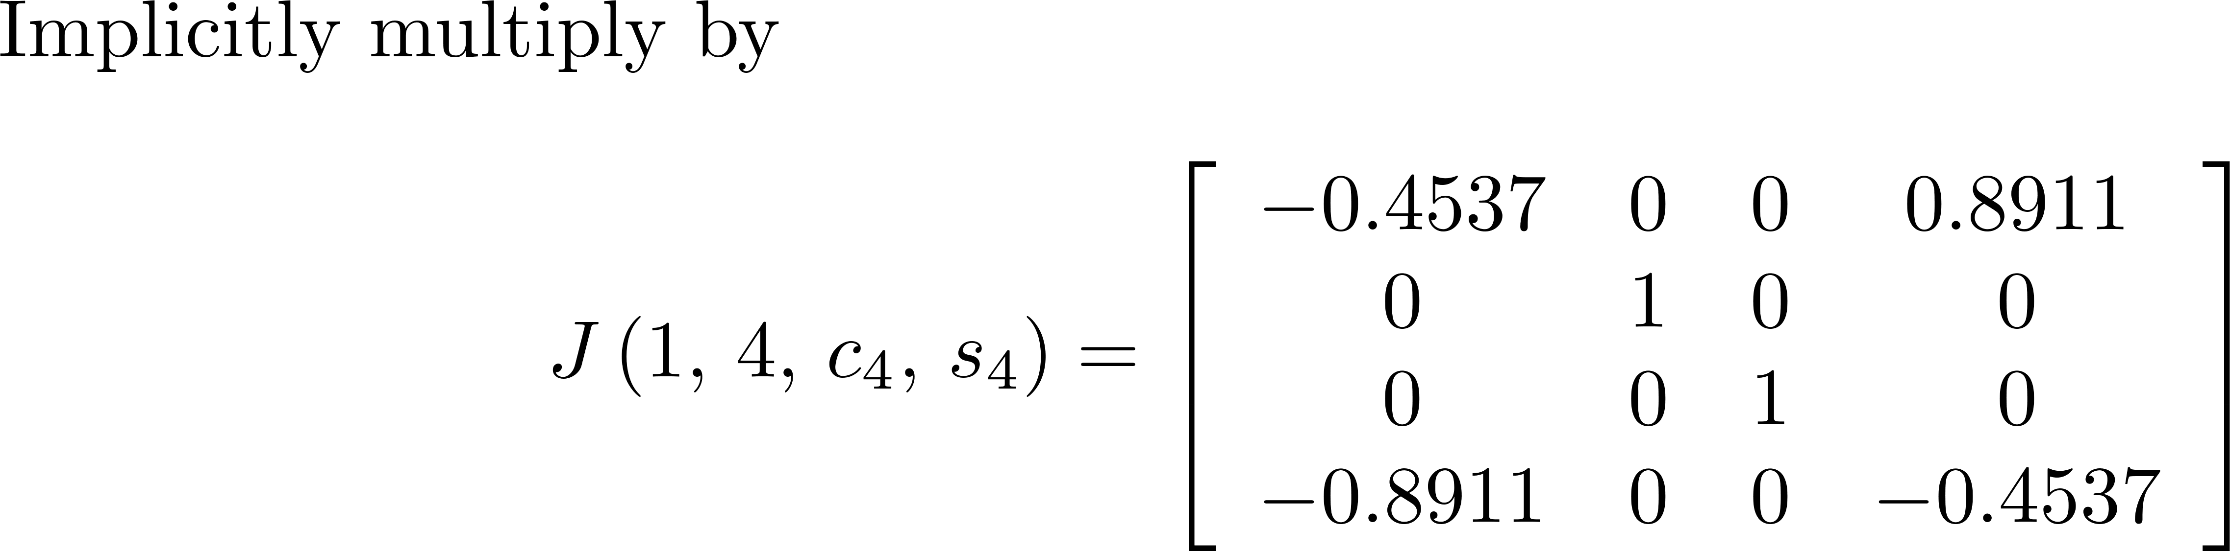
Example 4

Slide 24
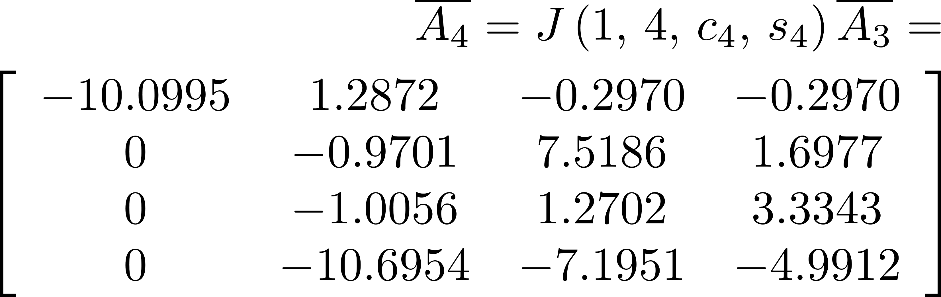
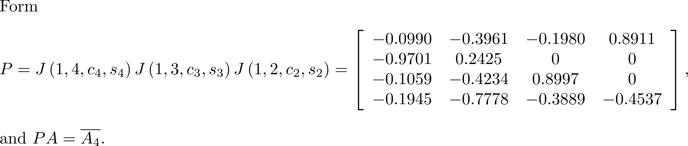
Example 4

Slide 25
Accuracy Improvement
The computation of c and s can have problems with overflow or underflow. Just as we rearranged the computation of the quadratic formula in Section 8.4.2 in order to avoid computation errors, we need to do the same thing here. The following algorithm provides improvement in overall accuracy.

Slide 26
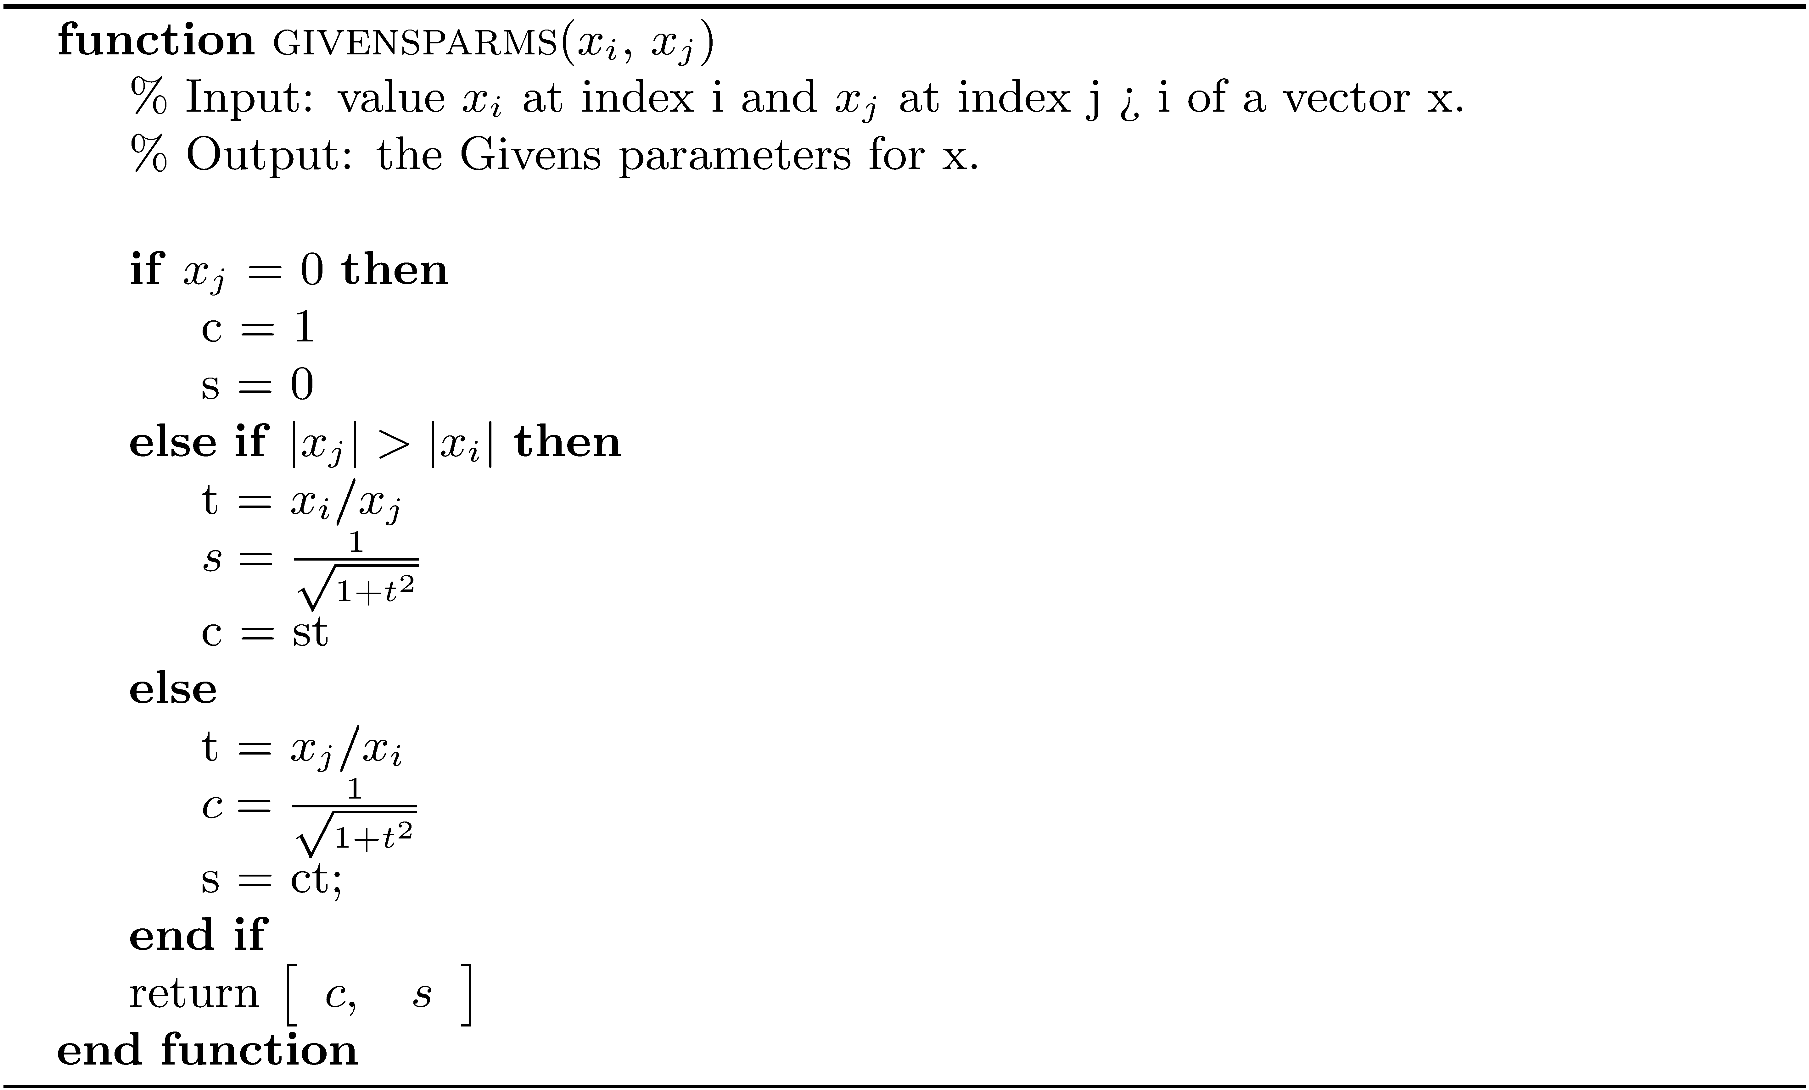
Computing the Givens Parameters

Slide 27
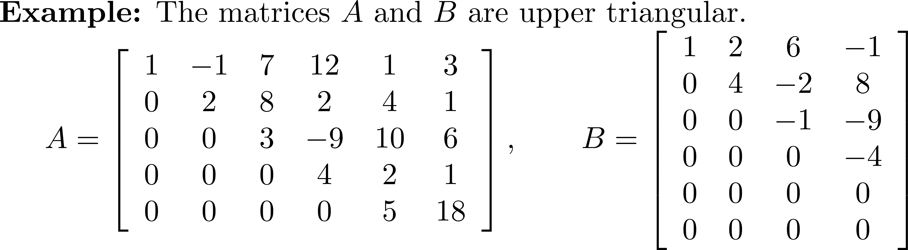
General Definition of an Upper Triangular Matrix

Slide 28
The Givens Algorithm for the QR Decomposition
The number of steps in the Givens QR decomposition algorithm is k= min ( m-1,n ).
To compute Q , start with Q=I . Build Q by successive uses of givensmul.
When the rotations have produced R , QA=R , and so A= Q^{T}R . Thus, the Q returned is the transpose of the one built during the construction of R .

Slide 29
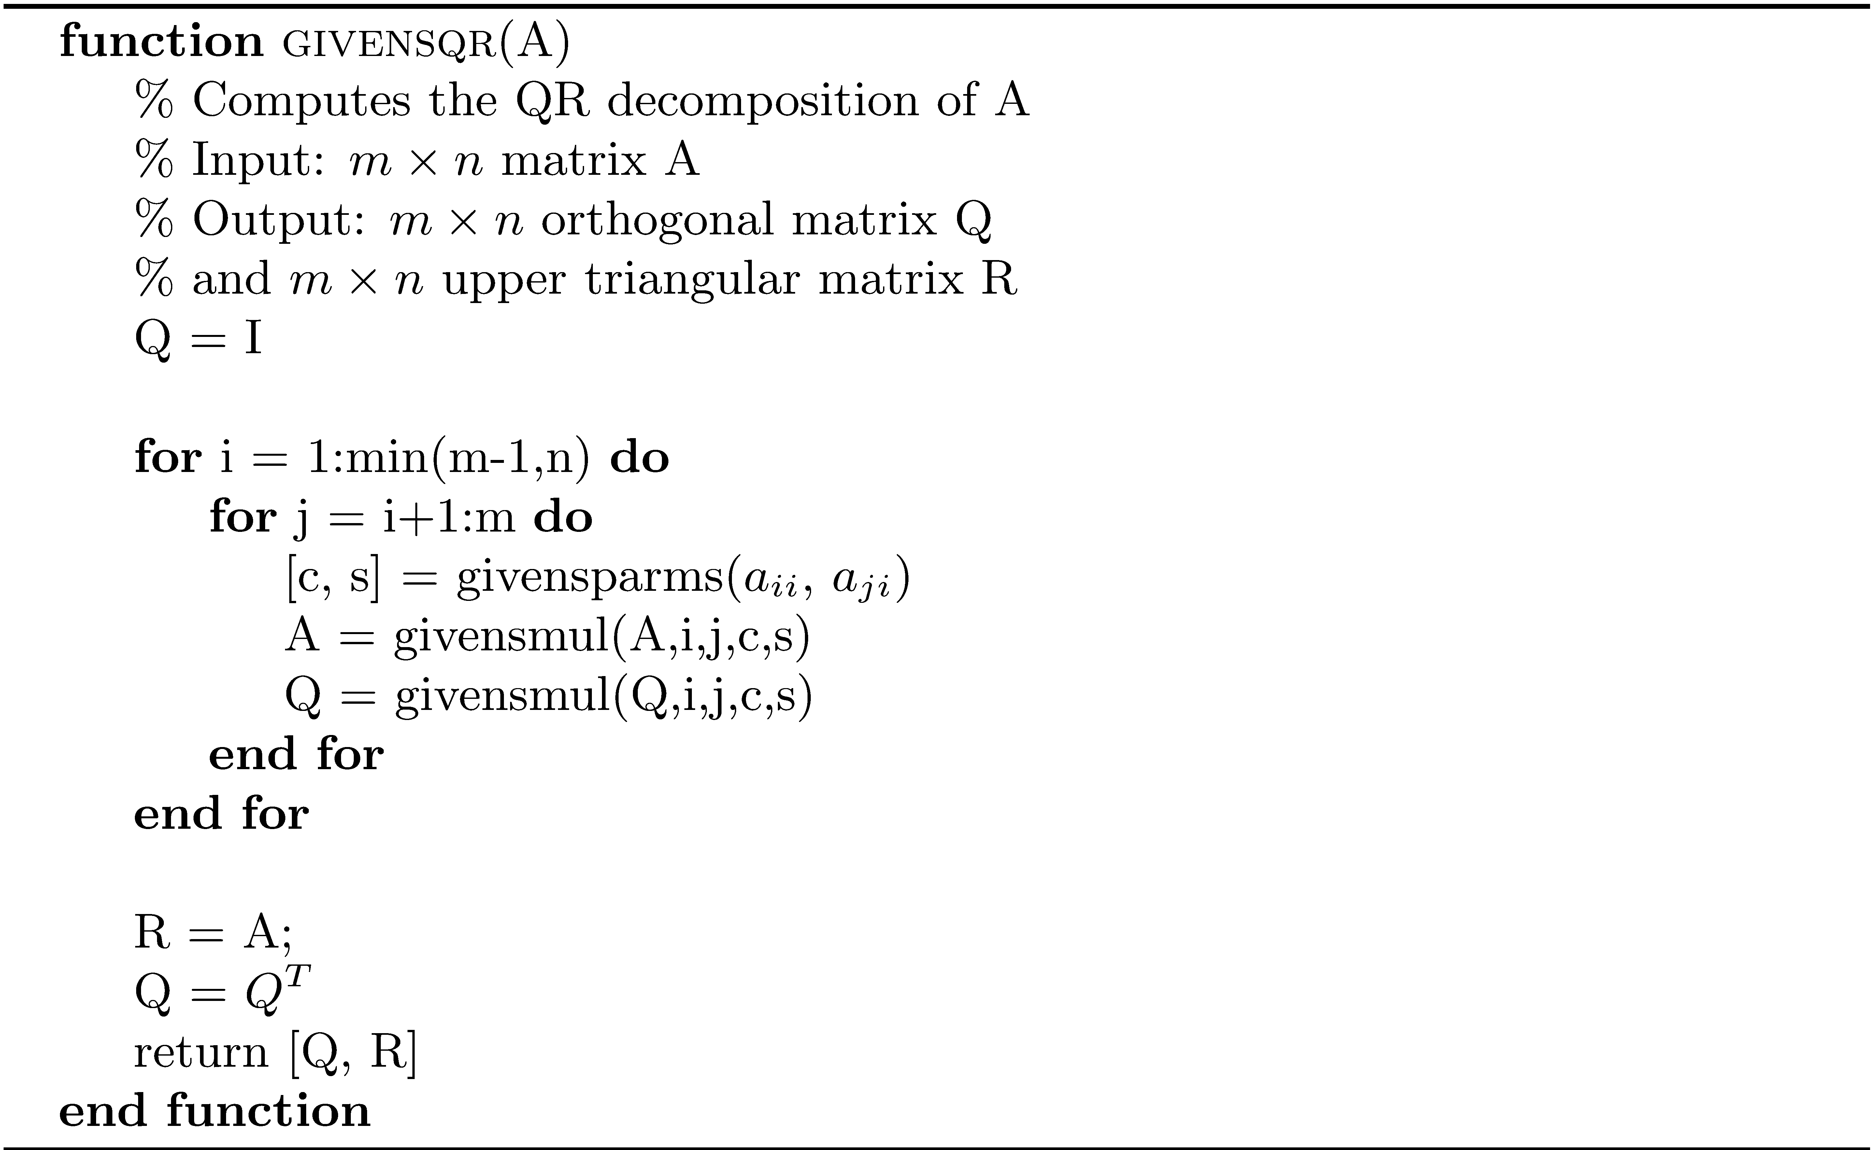
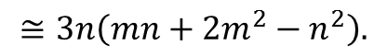
Givens QR Decomposition
For m > n, flop count
$$≅3n\left(mn+2m^{2}−n^{2}\right).$$

Slide 30
Example 5
>> H = hilb(5);
>> [Q R] = givensqr(H);
>> norm(eye(5) - Q'*Q)
ans = 5.6595e-016
>> H = hilb(15);
>> [Q R] = givensqr(H);
>> norm(eye(15) - Q'*Q)
ans = 1.0601e-015
Compare these results to those of
Example 1.

Slide 31
Householder Reflections
A Givens rotation zeros out one element at a time, and n-i rotations are required to eliminate elements below a_{ii}.
The Householder reflection zeros out all the elements under a diagonal element a_{ii} in one multiplication.

Slide 32
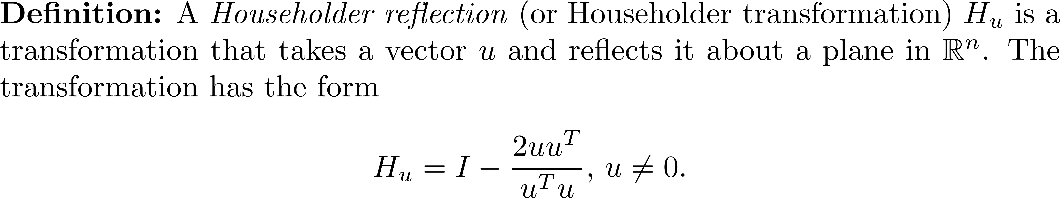
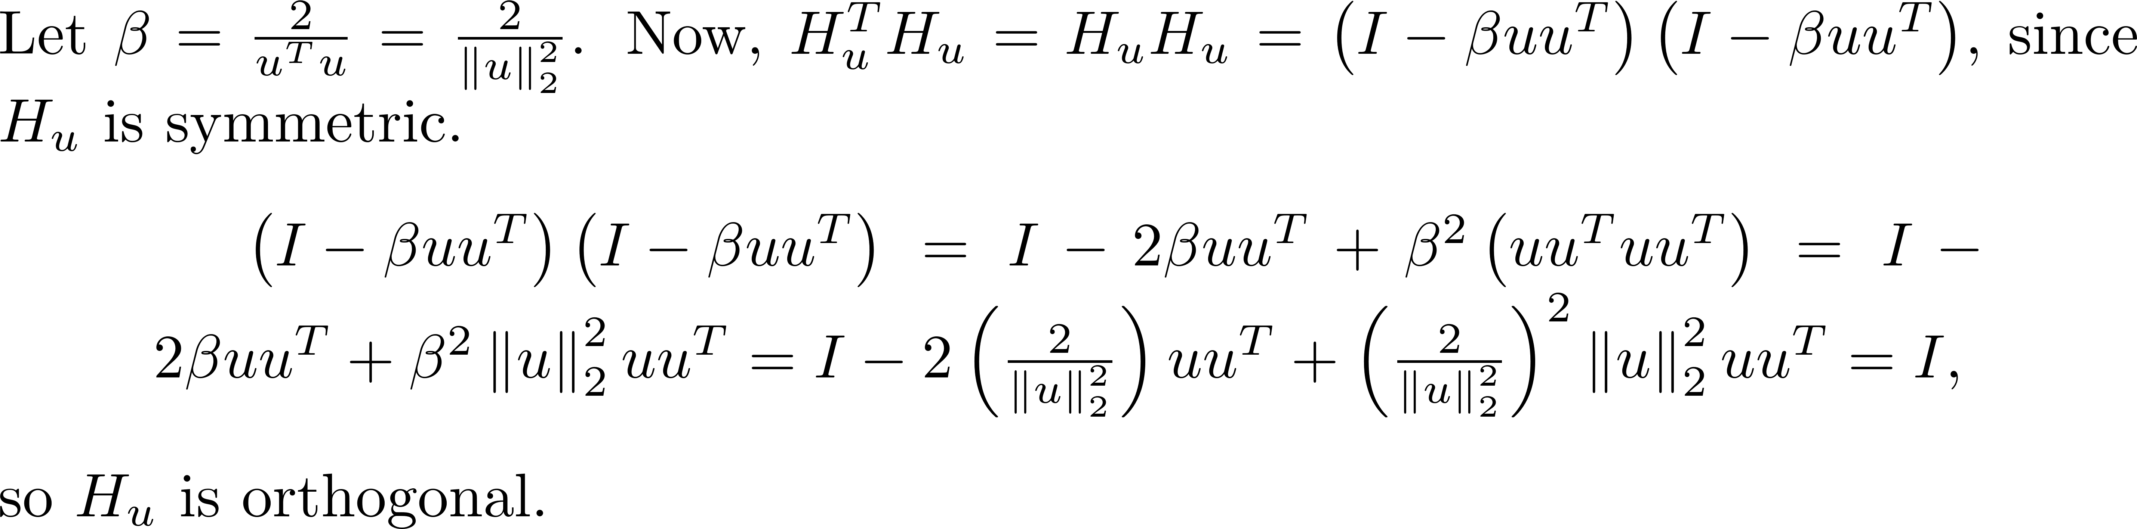
Householder Reflections
H_{u} is an n × n matrix, since uu^{T} is a matrix of dimension n × n.
H_{u} is orthogonal.

Slide 33
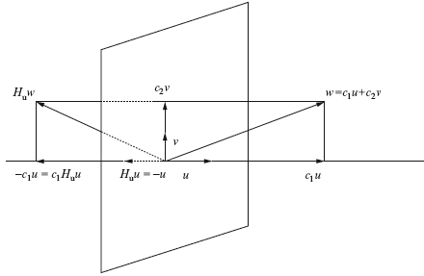
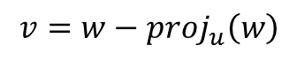
Householder Reflections
Geometric interpretation
Hu(ku) = -ku, and H_{u}(w) is a reflection of w in the plane through 0 perpendicular to u.
$$v=w−proj_{u}\left(w\right)$$

Slide 34
Householder Reflections Properties
H_{u} is symmetric.
H_{u} is orthogonal.

Slide 35
Matrix Column Zeroing Using Householder Reflections
A single Householder reflection can zero out all the elements below a diagonal element a_{ii} in one multiplication.

Slide 36
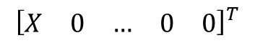

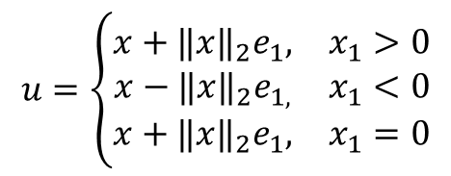
Matrix Column Zeroing Using Householder Reflections
Let x be the first column of the m n matrix A. H_{u}x is the first column of H_{u}A. Find u such that H_{u}x is of the form . Some analysis shows that
$$×$$
$${\left[\begin{matrix}X & 0 & … & 0 & 0\end{matrix}\right]}^{T}$$
$$u=\left\{\begin{matrix}x+{‖x‖}_{2}e_{1}, & x_{1}>0 \\ x−{‖x‖}_{2}e_{1,} & x_{1}<0 \\ x+{‖x‖}_{2}e_{1}, & x_{1}=0\end{matrix}\right.$$

Slide 37
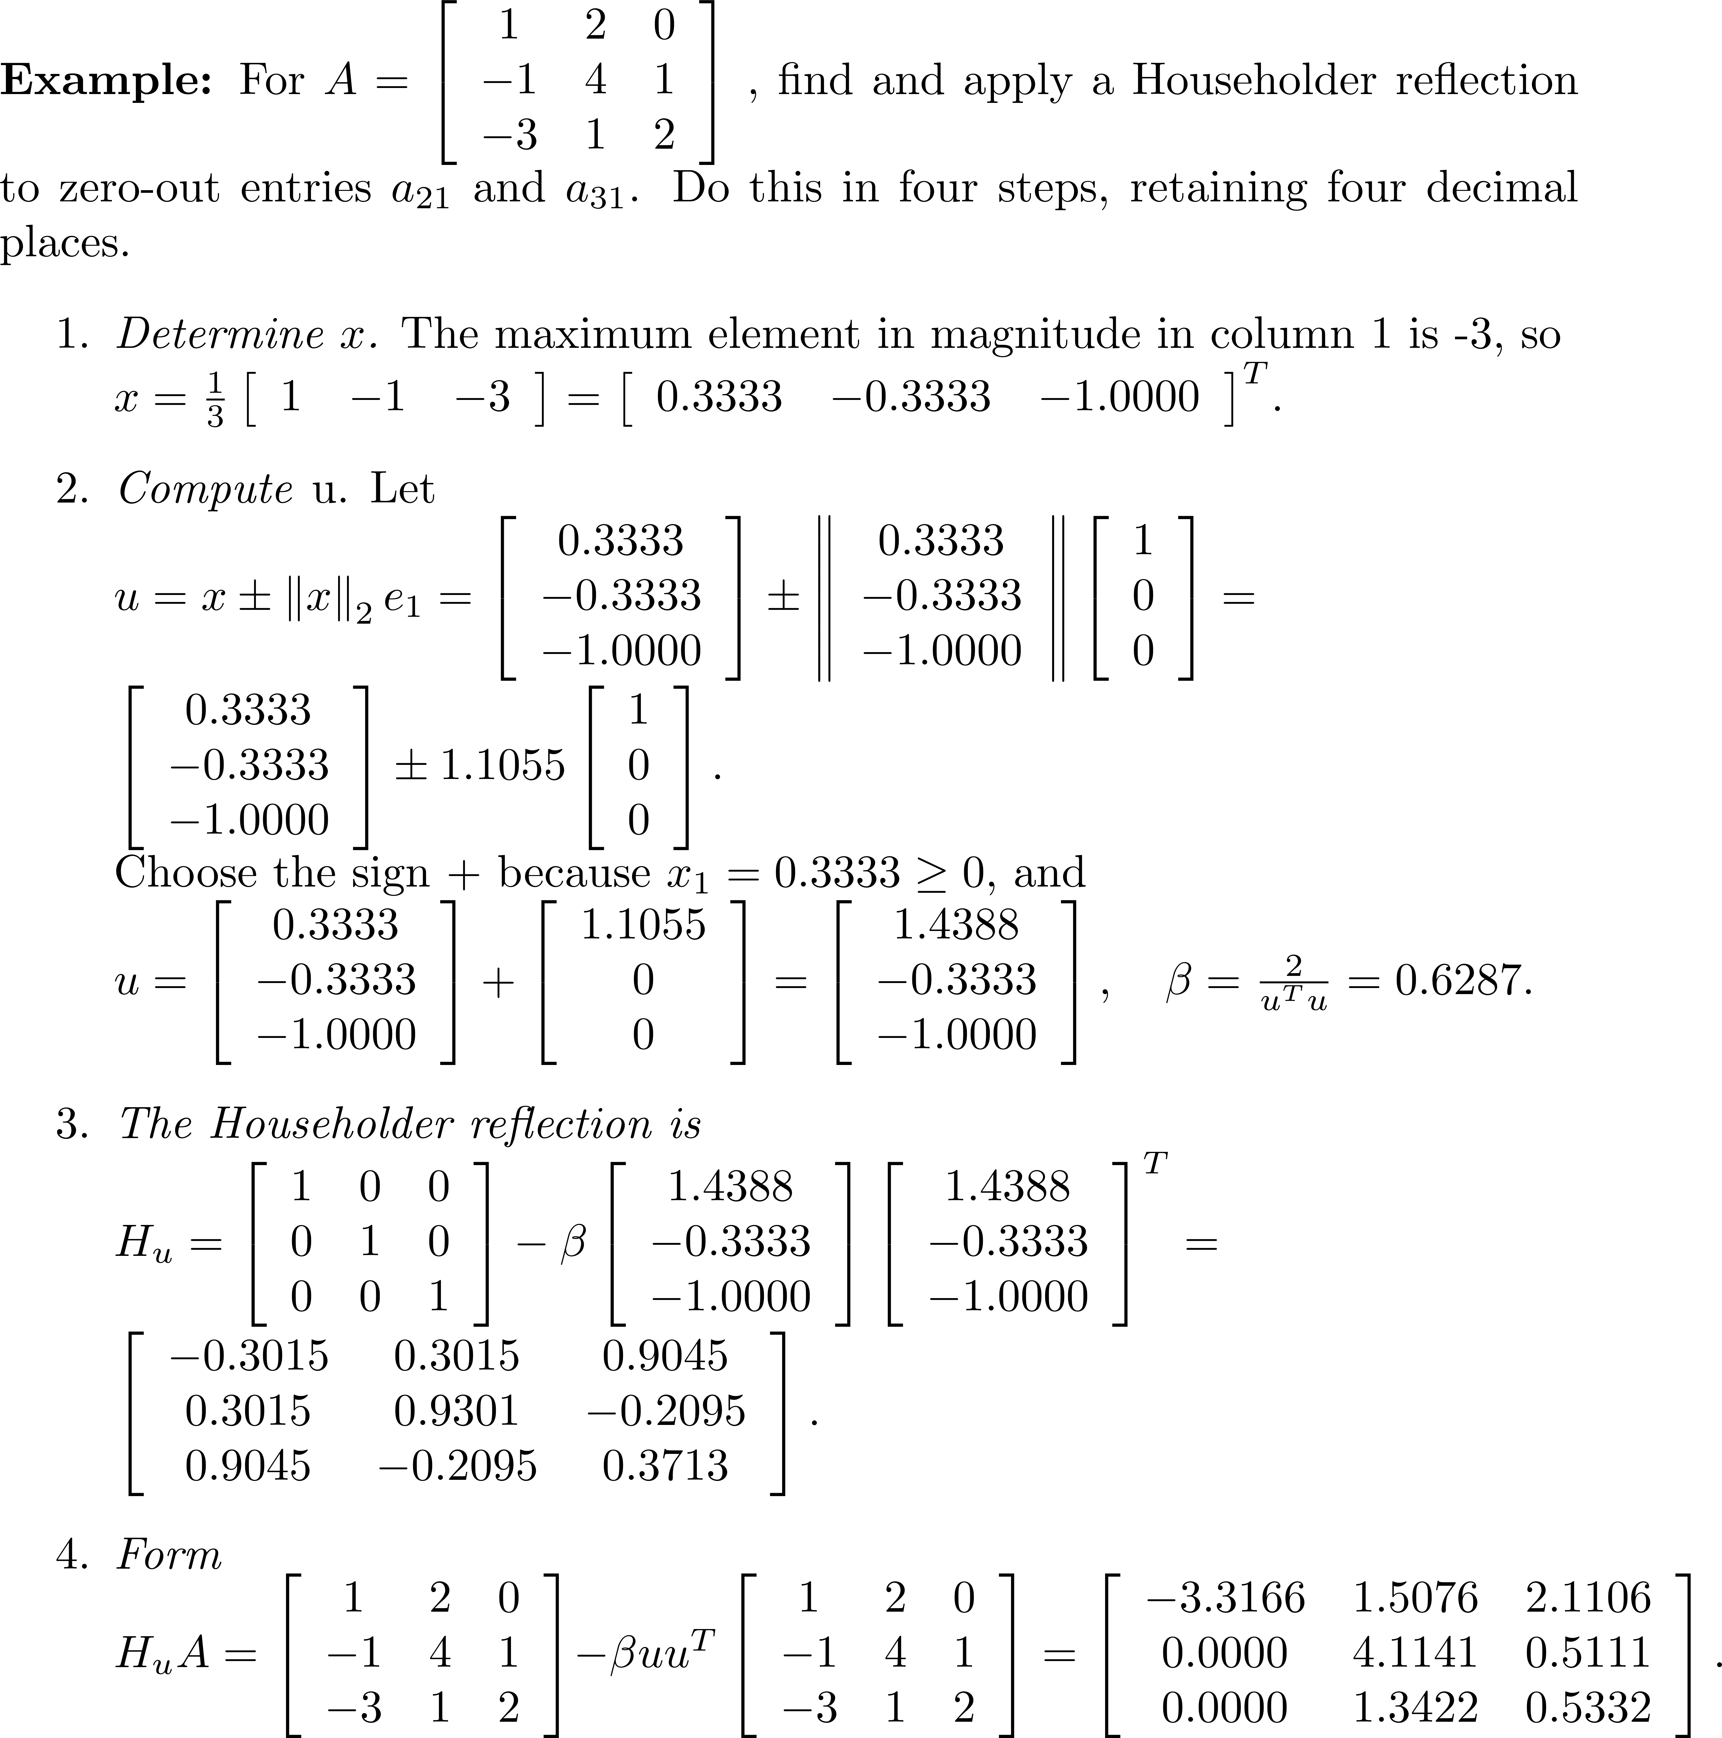
Example 6

Slide 38
Implicit Computation with Householder Reflections
As was the case with Givens rotations, multiplication by a Householder reflection H_{u} does not require construction of the matrix. If H_{u} is an m × m Householder matrix, x is a vector in R^{m} , and A is an m × n matrix, then the products H_{u}x and H_{u}A can be computed by a simple formula. If H_{u} is an n × n matrix, then the same is true for AH_{u}.

Slide 39
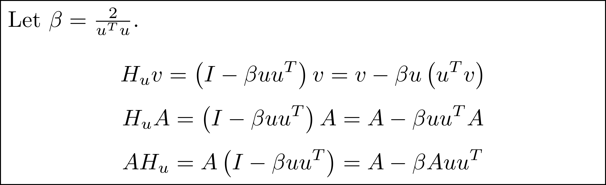
Implicit Computation with Householder Reflections

Slide 40
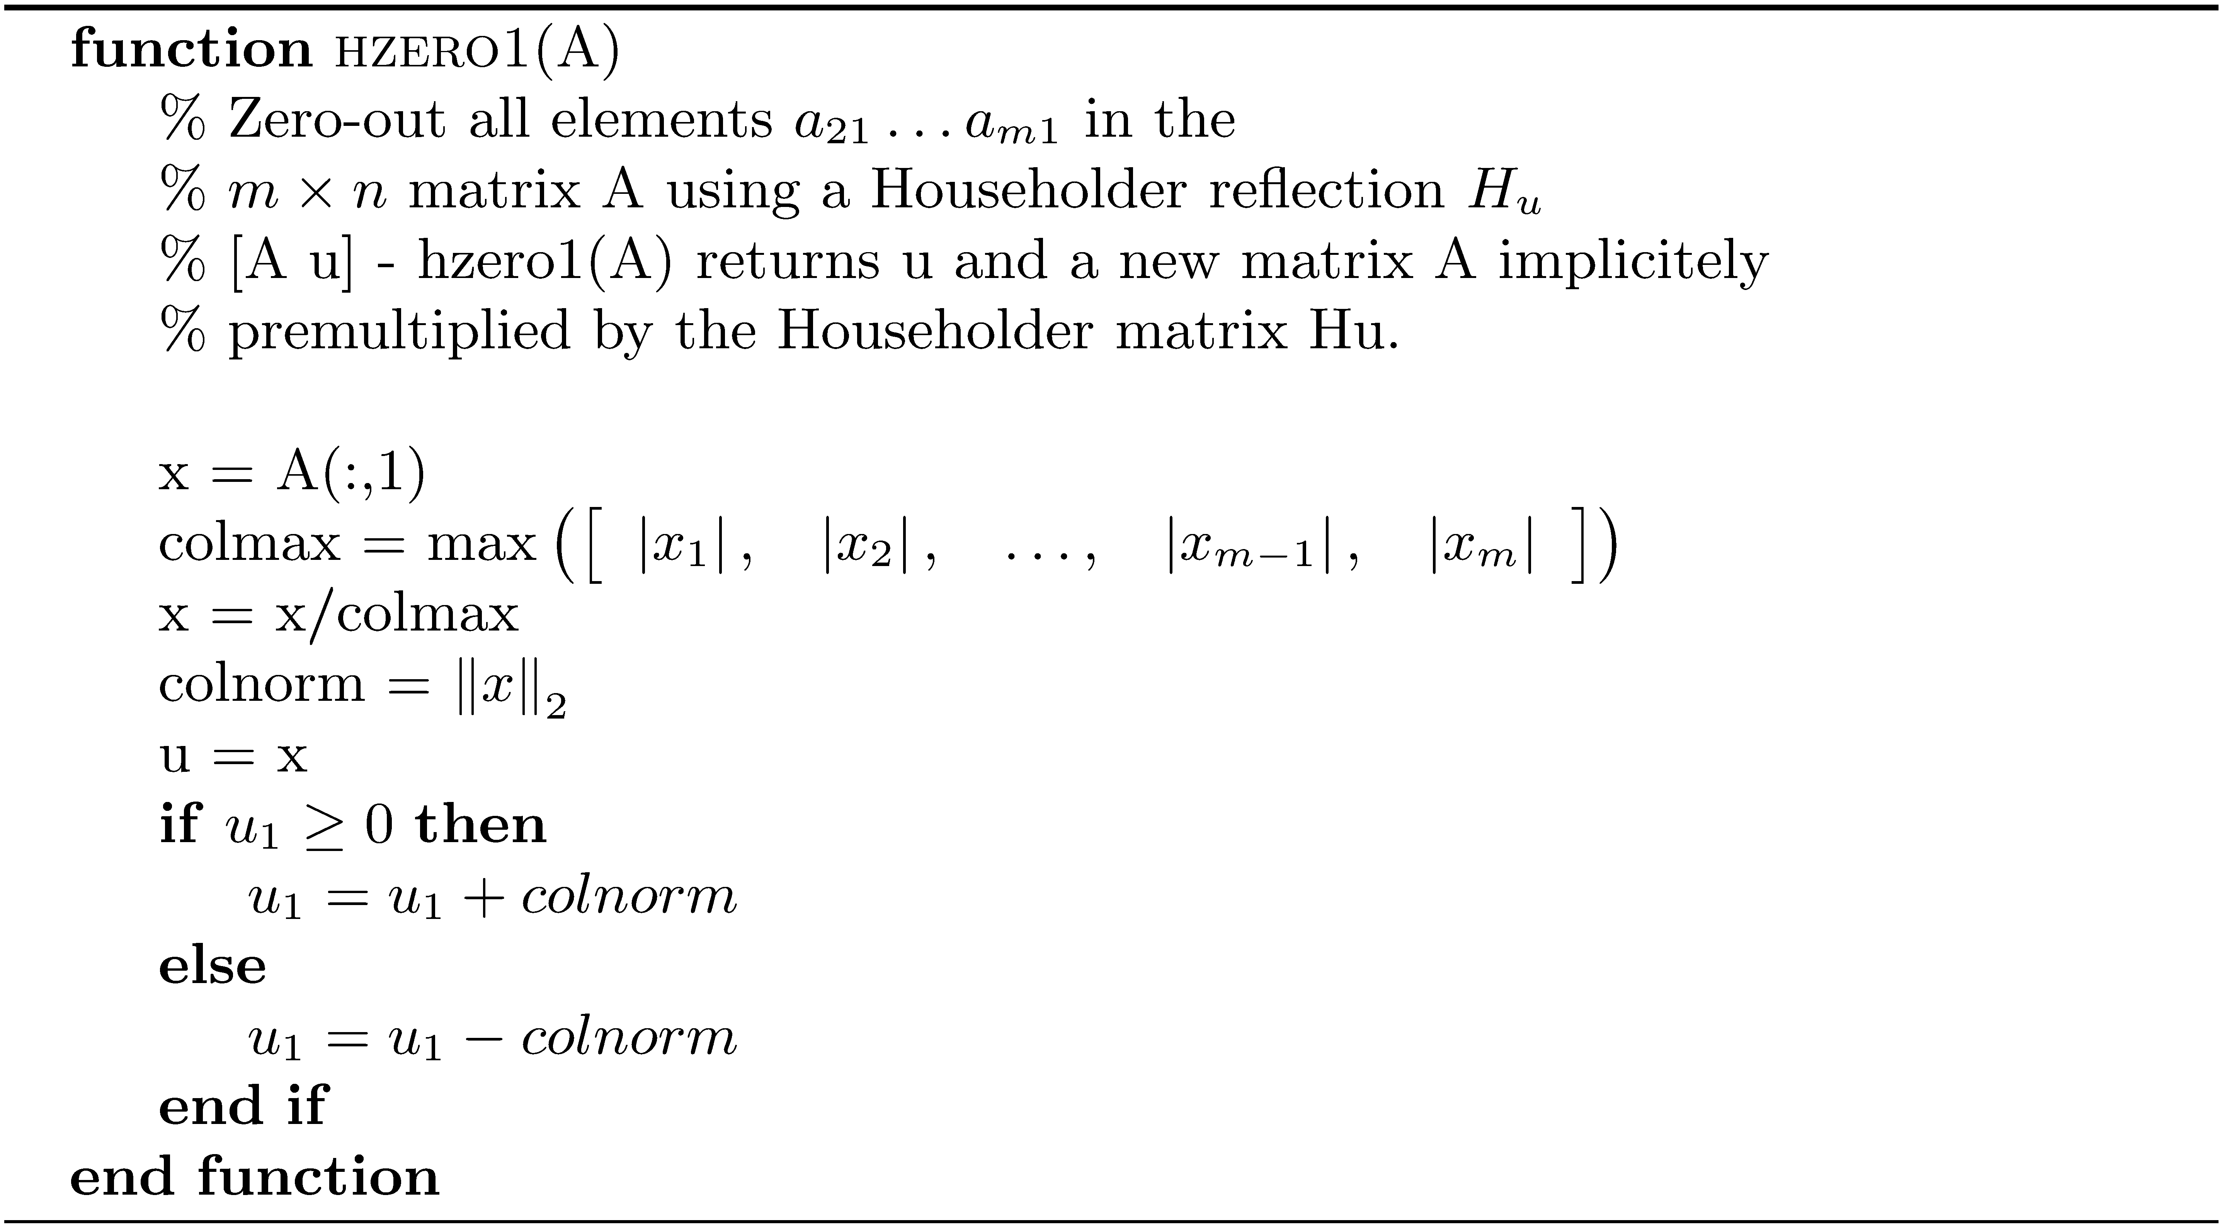
Zero Out 1st Column Matrix Entries using a Householder Reflection

Slide 41
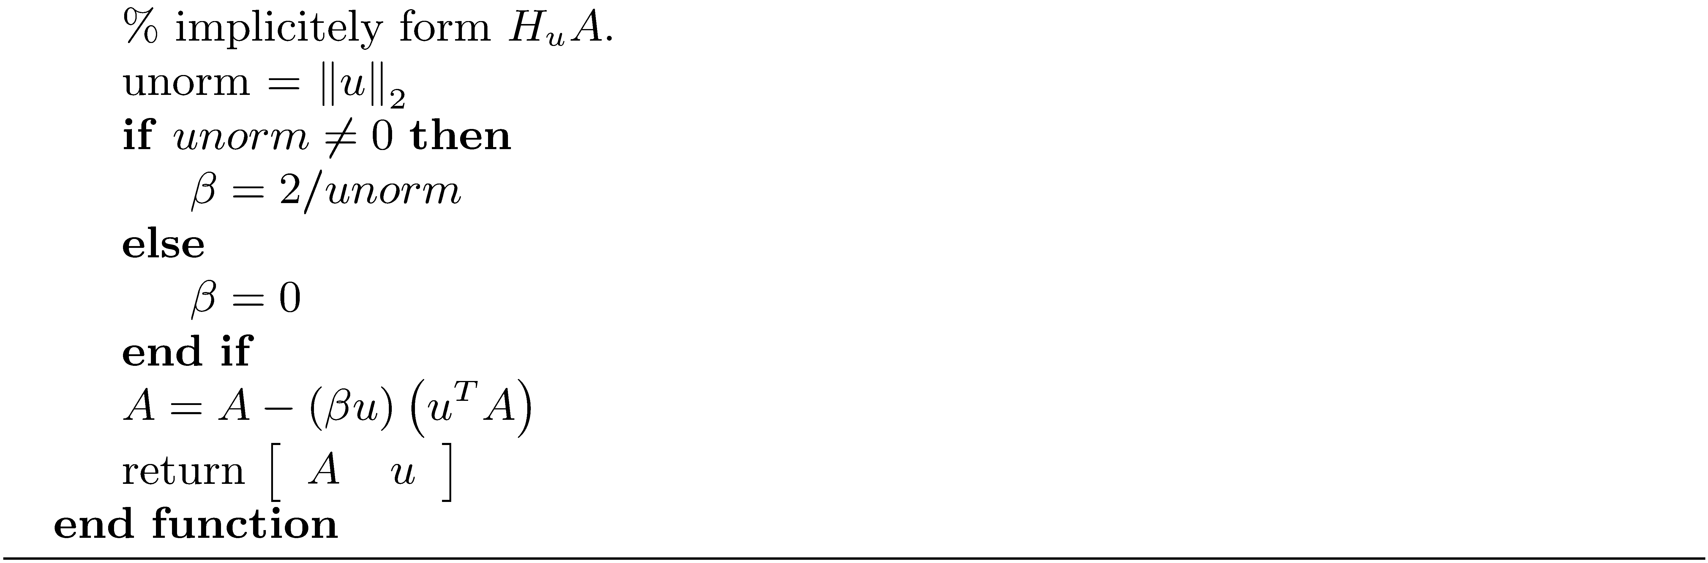
Zero Out 1st Column Matrix Entries using a Householder Reflection

Slide 42
Computing the QR Decomposition Using Householder Reflections
To transform an m × n matrix into upper triangular form, we must zero-out all the elements below the diagonal entries a₁₁ , a₂₂ , … , a_{kk} ,where k= min ( m-1,n ) .
Create a sequence of Householder matrices that deal with submatrix blocks. Relative to the current block, a₁₁ is in the upper left-hand corner. Use hzero1 with the block.

Slide 43
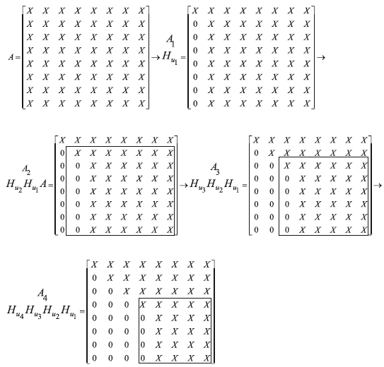
Computing the QR Decomposition Using Householder Reflections
Apply hzero1 to all of A.
Apply hzero1 to A(2:m,2:n).
Apply hzero1 to A(3:m,3:n).
Apply hzero1 to A(4:m,4:n).
Transforming an m × n Matrix to Upper Triangular Form using Householder Reflections

Slide 44
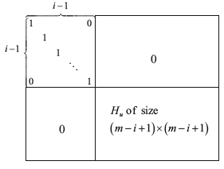
Computing the QR Decomposition Using Householder Reflections
The application of hzero1 is the result of implicitly multiplying on the left by the Householder reflection

Slide 45
Example 7

Slide 46
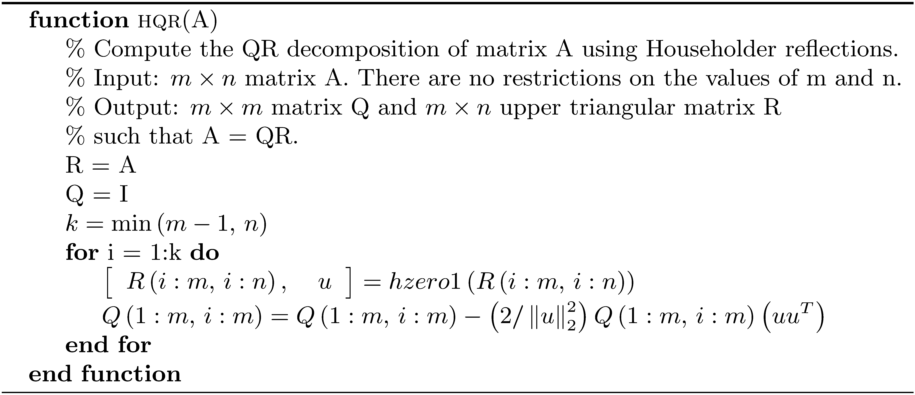
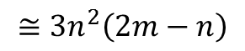
Algorithm hqr
Flop count:
$$≅3n^{2}\left(2m−n\right)$$

Slide 47
Example 8
>> x = -1.0:0.01:1.0;
>> V = vandermonde(x,20);
>> cond(V)
ans = 1.7067e+007
>> [Q R] = hqr(V);
>> [QM RM] = qr(V);
>> norm(V - Q*R)
ans = 5.9967e-014
>> norm(V - QM*RM)
ans = 9.5622e-015
>> norm(Q'*Q - eye(201))
ans = 2.6553e-015
>> norm(QM'*QM - eye(201))
ans = 1.7922e-015

